Slide 1
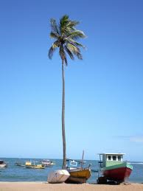
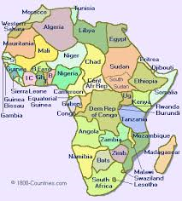
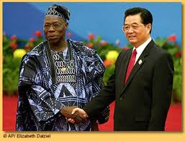
Africa and the Security Market Opportunity
Access Control System Limited

Slide 2
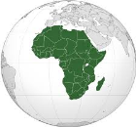
Summary
AFRICA
Slide 1 - Cover Page
Slide 2 - Summary
Slide 3 - Introduction
Slide 4 - Africa figures : some valuable data
Slide 5 - The security market and early stages in Africa
Slide 6 - Past barrier of entry
Slide 7 - Uniqueness of the African security market
Slide 8 - The current state of the African security market
Slide 9 - The Growth of the African Security market
Slide 10 - Succeeding in Africa – Acsys Technologies
Slide 11 - Acsys total solution – Cell Tower Management
Slide 12 - Acsys’ success was based on its market focus
Slide 13 - The Acsys solution to reduce Cell Tower down-time
Slide 14 - The Acsys Africa solution – CGS
Slide 15 - Product offering
Slide 16 - Conclusion

Slide 3
Introduction
AFRICA
Since the turn of the century, Africa has undergone a serious transformation that has even surprised most Africans. The continent was since the 1960’s ‘abandoned’ by many as political unrest, war, corruption and inequalities seemed impossible to resolve. For many years Western powers had stood by as wars and conflict took over the continent and instead of acting or helping in real ways, they chose to provide Aid which was mostly financial and humanitarian.
We all know the famous proverb : “if you gave a man a fish he will eat one day, if you teach him how to fish he will eat all his life” (Confucius) That comment is an epitome of what the “African problem” was all about; too much money, too much help but no real direction, plan or assistance to allow Africans to help themselves.
Since 2000 and with the advent of new global political powers in the world, the situation changed. The discovery of bigger than expected natural reserves, the political stabilization and the general feeling of long-term growth provided a glimpse of hope in what was a long period of trouble in a troubled continent.
The role of China and India in the recent development of Africa is significant, as they have provided previously unseen levels of aid. Many countries were skeptical, but the approach of the “Big Two” was different from ever before, they provided what no one had done before, they brought money, know-how, people and technology to make it happen instead of just providing money and hoping it would happen! They succeeded; most African continents today show robust growth and promising growth prospects and have proven to be financial safe-havens even during the financial crisis of 2008 that affected the whole planet except Africa.
I personally believe that Africa has become a big market thanks to communications. Until 10 years ago the vast majority of the continent was ‘unavailable’, but with the rapid deployment of Wireless Telecommunications, greatly supported by China it suddenly ‘opened’ itself to new opportunities.
With the growth of the continent also comes a numbers of “growth-pains”, such as lack of policing or the enforceability of laws, and this is exactly the new big opportunity for the Security Industry. We are at the dawn of a new era, Africa is new growth market but has specific requirements and demands. I believe that those demands will fuel the development of a new “breed” of products which are more autonomous, reliable, don’t require servicing and rely more on wireless technology than on wired technologies, the market is there…

Slide 4
Africa some Facts & Figures
AFRICA
Africa = in numbers
2nd largest and 2nd most populated continent
Population 1 Billion (2011)
Occupies 20% of the worlds land surface
17% of proven extractable natural reserves are on the African continent
Faces the Atlantic and Indian Ocean
54 countries
2000 languages but three main international languages are used English, French and Portuguese which are spoken and understood by about 60% of the continent’s population
50% of the population is less than 20yrs old
Origin of the name Africa is a Tunisian word “Ifriqiya” which means “Sunny Place”
Annual turn-over of Security industry in South Africa alone is 6 Billion USD

Slide 5
The Security Market, and the early stages in Africa
AFRICA
- Every country and every continent has its own unique way of developing business-
In the past two decades, Globalization has opened markets at an incredible pace. During this period companies have had to experience that it is wrong to assume that a Western or Asian business model will apply to some developing nations, this is also the case with Africa.
The African market is through its culture, history and politics shaped in a completely different way than other markets. Most capitals in Africa today have nearly everything available going from basic foodstuffs, basic FMCG as well as luxury outlets for accessories or cars, in many ways what is available in Shanghai or London is for a certain amount of the population also available in Johannesburg, Nairobi or Lagos. The way these products are brought to market is however not similar to the way it is brought to market in developed nations and this point is critical in understanding how to do business in Africa.
The security market in the Western world and Asia is very fragmented with all areas of the value chain being exploited by specific players. In Europe the model is very fragmented, it is common to see manufacturers deal only with distributors who in turn deal only with installers who deal with end-users; in Asia and specifically China we can see that the market is in many segments completely integrated, the manufacturer deals with the end-users and in some cases even assures installation and after-sales support and are the sales-drivers. The US is another example where manufacturers rely heavily on a distribution network and various echelons in the service industry to bring their products to the market and rarely enter the real market themselves.
The African Security market is structured in its own ‘unique’ way and this mainly through the difficulties African nations have had to build their infrastructures caused by years of corruption, neglect and outright poverty. After most of the colonizing countries had left a “security vacuum” was created whereby nations suddenly became their own masters, but didn’t dispose of all the tools to run their countries, in many cases “policing” was one of the tools they were missing.
This “security vacuum” was filled by various managed security services companies who became “private armies” or sometimes referred to as “private police”. These private companies suddenly became entrusted with a role that the public sector was not able to assume and therefore became next to Governments the biggest users and buyers of security products and have for the greatest part of the 20th century shaped the demand of the market, which we can label as ‘restrained’ until the market opened up begin 2000.

Slide 6
Past Barrier of Entry
AFRICA
For most of the second part of the 20th century the African security market was very complicated to approach and work with and this for many reasons :
From the Seller’s perspective
Main customers were government and military which require very specific connections
As most countries were politically unstable, project managers would frequently change making the sales cycle long and uncertain and prone to a lot of corruption
It was difficult for people to travel to Africa or for Africans to travel abroad
It was logistically complicated and costly to send goods to Africa, and there were too many issues with customs
Political instability also led many people to hold off on purchases or investments until situation came back to normal which in some cases could take years
No effective trade shows available
Overall situation was unstable, sellers preferred to focus on other markets
From the buyers’ perspective
Most security products designed in EU/US required know-how, power and other equipment which Africans often didn’t have or couldn’t get making them obsolete
EU/US products were made for those markets and often didn’t survive long in Africa
Africans were worried to invest in certain technologies as there was no local support/installation or after-sales and lack of training to INSTALL/SERVICE & SUPPORT these products.
Currency restrictions made it difficult to buy goods abroad and pay in foreign currency
Cost of goods made in EU/US remained for 99% of the people un-affordable

Slide 7
Uniqueness of the African Security Market
AFRICA
Because of years of conflict, a lot of fire-arms are available and many people have received military training, simple deterrent solutions don’t work in Africa
As the electricity grid is inefficient, solutions that require a lot of DC power are harder to sell then battery-operated ones, but also since the availability of battery types is limited only products with mainstream batteries are chosen
The climate and environment in Africa is specific, from very dry sandy areas to very high humidity tropical areas and coastal areas, products need to withstand extreme conditions
Because of the lack of education, people are not familiar to use complicated systems, the African market requires easy-to-use solutions which are preferably ‘Plug&Play’
The African market is requiring products to either have a long life cycle or be able to be serviced locally
Products need to also withstand simple vandalism
In the past there were no or few integrators except Governments or Army the market was not able to ‘absorb’ solutions which required integration
African people habe become through years of poverty and lack of availablity of products, very ressourceful in making their ‘own’ security solutions, one of them is glass on top of concrete walls which actually have an effect equal or better than that of barbed wire
Because of the huge income gap, the African market is very price-sensitive and therefore unwilling to pay premium prices for products, and are very satisfied with more simple solutions at a more affordable price
“SEEING IS BELIEVING” is a very important element in Africa, people don’t believe what is written on a brochure and usually discount all sales talk as not applicable to their situation; usually they are also very weary of the quality of products and will therefore take a ‘long-term’ vision when it comes to product acquisition, and would rather adopt the ‘step-by-step’ or ‘wait and see’ approach when deploying a solution

Slide 8
The Current State of the African Security Market
AFRICA
In the past 10 years, the security market has developed, flourished and become fragmented as in other territories and today the market can be cut in the following segments :
Government (Public sector and Army)
Managed Security Service Companies
System Integrators
Multi-Nationals (Mining, Oil & Gas, Telecom, Logistics, Ports)
Security Product Installers/ Value-add resellers
High net worth individuals
HOW TO APPROACH THESE CUSTOMERS
Trade fairs and exhibitions in the region (South-Africa/Dubai/India) and APSE in August 2014
Opening of permanent representation locally
Having products specified by consultants/architects internationally
Partnerships with local “distributors” and “business facilitators (a.k.a agents)
Working with end-users directly in for ex Telecom/Oil&Gas etc
Internet and Print promotion
CRITCAL GUIDELINES WHEN APPROACHING THE AFRICAN MARKET
Products need to be easy to use, easy to install and easy to service
As there are no major distributors, the single-order quantities need to be reasonable
If the product is complicated it will require local installation and training provided by the manufacturer (Huawei/ZTE)
Be prepared to customize the product to be fit for the local market

Slide 9
The Growth of the African Security Market
AFRICA
The African security market has grown extensively over the last 10-15 years mainly thanks to the following
The finding of natural resources creates income for otherwise poor countries and creates related industries that require a lot of security
The Political stabilization brought with it a lot of Foreign Direct Investment (FDI) (among others in the natural resources sector) which is another pillar that allow the security market to grow
The same stabilization has also led to internal markets to grow, meaning that there is in Africa a strong growing upper and middle-class who all have security concerns due to their new found wealth
The increase of the literacy % has also helped build more “awareness” of what is available
The access to the Internet is surely one of the big drivers for growth
The availability of buying platforms such as Ali Baba which allows smaller buyers to get a piece of the action has “opened” up the market significantly
Globalisation and the fact that everyone now wants similar products has brought a lot of competitiveness to the market which in turn has made the products more affordable for everyone
Access to the WTO and the opening of trade barriers has also eased foreign currency transactions and the ability to import goods from abroad with less ‘customs improvisations’ than in the past
The infrastructure investments made by China in roads, ports, electricty and telecom has “opened” up the continent for business

Slide 10
Succeeding in Africa – Acsys Technologies Ltd
AFRICA
Acsys has been present in Africa since 2007
We were the first mechatronic lock manufacturer to show interest in Africa, when most companies were focusing on higher growth markets, this gave us a very important marketing advantage and a first-mover opportunity
Africa is like many other continents a ‘follower-market’ meaning that buyers will only buy products from you if you can demonstrate that these products have been installed and work in the Africa environment (the “seeing is believing” concept as mentioned before)
Our approach in the African market has been as follows :
Split the continent in high-revenue and low-revenue potential and focus entirely on high-revenue areas
Adopt a two-tier business model :
Direct sales to large customers (mainly Telecom/Energy and Government) where we can control the sales cycle and deliverables
Indirect sales through local distributors/integrators, used more for general brand promotion
Focus on getting a FIRST successful reference on the ground from a prominent customer, even giving special discounts and/or payment terms to get that reference
Use ‘sales momentum leverage’ to get second and more orders based on the first reference
Offer a “full-service” after-sales model which means that people are available locally to help with support and potentially extension of the system
Africa is a large market, but a small place, everyone knows everyone and hence when a product is proven to work, the word of mouth marketing is actually very efficient and delivers results in a much better way than any other way of promoting the product.
We have customized our products extensively to the ‘local’ environment which for example takes into account that Africa still has : low bandwidth, no or bad mobile connectivity, no or little access to grid power, lots of poverty, lack of education and deals with a lot of “ignorant” theft(people don’t know if what they are stealing is sell-able)
We have provided local installation and support, dedicated African after-sales support (ie local not central)
We continue to customize our products as the situation evolves

Slide 11
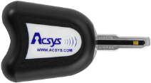
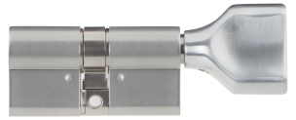
Acsys Total Solution – Cell Tower Management
AFRICA
HIGH SECURITY LOCKS /KEYS
ACCESS CONTROL SYSTEM
TIME & ATTENDANCE SYSTEM
KEY MANAGEMENT SYSTEM
LED light on the AcsysKeys gives user information:
GREEN – ACCESS GRANTED
ORANGE – ACCESS DENIED AT THIS TIME
RED – ACCESS DENIED
4 blinks (color depending on the above) – LOW BATTERY
Since there is no power in the locks
We can offer Euro – Din cylinders and padlocks in various sizes
All models are
Wire-Free
EASY to Install
EASY to Maintain
The ONLY power source for the Acsys system comes from the key
Battery life-time = 2 years
AcsysLocks CANNOT be BUMPED or PICKED and are very hard to DRILL
AcsysKeys can be fitted
with a Proximity / RFID coil
allowing the user to use the key as a badge (optional)
The COMMUNICATION between locks, keys, software and all its data is encrypted using 128-bit AES ENCRYPTION, making the keys IMPOSSIBLE to COPY
AcsysKeys have a built-in
CLOCK and CALENDAR
So we can make access
rights temporary
(Mon-Fri) but also limited in time (08:00 – 18:00)
The key has a chip that can be programmed to open one or up to 100,000 locks
The lock has a built-in chip that can be programmed to accept the entry of 1,000,000 keys
Optional Keypad Key – security
against fraudulent usage.
Password keypad on key
The key and lock each have a
built-in MEMORY that keeps track of the last 1,000 events, WHO went WHERE and WHEN
LOST/STOLEN KEYS can be DELETED from the system and from the locks where it had access
Activity Reports
11

Slide 12
Acsys success was based on its market focus
AFRICA
Our product was originally designed to solve the problem of copied keys, keys being used when they shouldn’t be used, and the effect of lost/stolen keys which have as a result that locks need to be changed.
Even though the most logical markets for our product would be Europe, Asia and the Middle-East, we decided to also include Africa in our sales efforts.
We first started by identifying areas where our product would be used, not as a ‘nice to have’ solution, but focused on where the product could be used and increase operational control and reduce losses, when this segment is identified, it is easy to calculate what people would be ready to spend to curb these losses…
Our research allowed us to identify specific sectors that needed solutions like ours which were :
Telecom industry
Banking industry
Logistics and warehousing industry
Oil/Gas/Mining industry
Military
Government
We adapted our marketing and sales pitch to those verticals by making extencive market research into identifying all of the problems in those verticals
Our proposals took into account the “real situation” which meant that we adapted our exisiting solutions to that market ex – SMS instead of App, 3G instead of Wifi, automatic back-ups (instead of manual back-ups) etc..
As our whole system is managed by a software, and based on the ffedbacks that we had received since 2007,we developed a WIZARD based software which made training on the software very easy and reduced errors to a very low one digit %
“eliminate’ the Human element as much as possible within the whole process as the human is prone to corruption, collusion, error (through lack of education) or outright lazy-ness

Slide 13
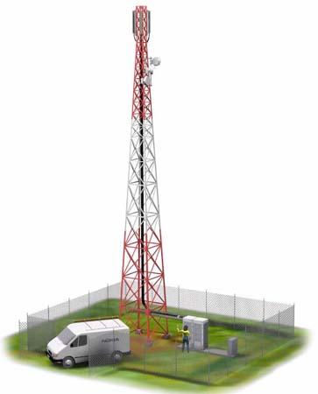
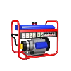
The Acsys solution to reduce Cell Tower DOWN-TIME
AFRICA
B.
Before
B.
Acsys
3rd party supplier
1
3
Key can be copied
A.
3
3rd party supplier
A.
HQ
Key can be copied
HQ
1
2
2
Mast Goes Down / Maintenance / Refuel
Technician receives a call
Picks up the Mast A key from HQ, Goes to remote site Mast A
Completes the maintenance and brings back key Mast A
Picks up key for another mast and repeats process
Mast Goes Down / Maintenance / Refuel
Technician receives a call,HQ prepares Access rights
Technician obtains access rights to open one or more locks using CGS solution and his mobile phone
Does maintenance and locks then moves to next site
HQ is notified in REAL-TIME of Technicians access
ACSYS SEGMENTED ACCESS ILLUSTRATION
LADDER
WORKER 1
WORKER 3
Can only open FRONT GATE and LADDER
Can only open FRONT GATE and GENERATOR
BTS
FRONT GATE
GENERATOR
WORKER 2
WORKER 4
Can only open FRONT GATE and BTS
Can open ALL locks
13

Slide 14
The Acsys Africa solution - CGS REAL-TIME access control
Real-Time wire-free Key control
AFRICA
Need Access
OPERATOR
REAL-TIME
Get Code
Acsys
Need Access
Code
Generating
System
SMS
REAL-TIME
SMS
Get Code
A.
PASSWORD
B.
PASSWORD
SMS
SMS
SERVER
KEY PIN CODE
KEY PIN CODE
1. The worker has a password key and needs access to some locks
2. The worker calls the operator, gives his password, and receives a code to use the key
1. The worker has a password key and needs access to some locks
2. The worker sends SMS and password requesting access and gets a code to use the key
or
4. The worker can now use the key on the specified locks
for a defined duration
(5min/30min/1HR/8HRS)
3. The worker inserts PIN code to use the key, GREEN FLASH= can use the key
4. The worker can now use the key on the specified locks
for a defined duration
(5min/30min/1HR/8HRS)
3. The worker inserts PIN code to use the key, GREEN FLASH= can use the key
14

Slide 15
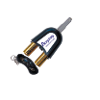
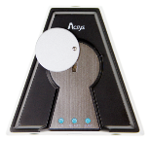
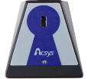
Product Offering
AFRICA
Keys Specifications
Key is impossible to copy
Key in reinforced ABS, UV proof, IP55, Rohs
blade in Stainless steel
Powered by 2x LR1 batteries
Battery autonomy 2 years/25k openings
Temperature from -10C to +65C
Logs last 1000 operations
4 Status LED (Access/No access/Restricted Access/Low battery)
Locks Specifications
Locks are impossible to pick/bump
Brass with stainless steel plating
Power comes from key (no battery)
No Wiring
EURO-DIN standard
Temperature -20C to +85C
Logs last 1000 operations
Sizes from 3cm to 14cm
Padlocks Specifications
Padlocks are impossible to pick/bump
Brass with stainless steel plating
Power comes from Key (no battery)
Operating temperature from -20C to +85C
Logs last 1000 operations
Programmer Specifications
Reinforced ABS, UV proof
IP 55, Rohs
Powered by USB (USB)
Powered by DC (IP)
111.26 mm
PADLOCK PL2
53 mm
Acsys Security Hasp for PL5
USB/IP Programmer
Step 1
Step 2
Step 3
Step 4
134.6 mm
click
Logger Specifications
Power comes from key (no battery)
No Wiring
Waterproof
Logs last 1000 key insertions
PADLOCK PL5
69 mm
The safest padlock in the world
Patrol Guard Logger
15

Slide 16
CONCLUSION
AFRICA
Africa has become a major market for the security industry
The current market size is estimated at 21 Billion USD annually (including managed services industry) and growing at a rate of about 10%/year
The market is very demanding for security products as the local situation isn’t completely stable, and when it stabilizes the market is demanding for higher-end products
The mining and mineral sector is in full expansion creating a large demand for security solutions
Poverty is still wide-spread which in turn means that security is sometimes necessary on assets that are totally disregarded in other territories which in turn provide new opportunities
The companies that have been successfull have brought know-how and not only products, this know-how will in turn provide more opportunities in the future as it spreads throughout the continent
A strong sense of entrepreneurship in Africa has helped to grow the market in many directions and opened new previously unknown opportunities
The fact that a large portion of the continent is either French or English speaking reduces the barrier of entry
81% of Nigerians use a smartphone to access the internet making the demand for mobile solutions and mobile-related security applications very significant and with great growth prospects
Companies that ‘adapt’ to the local environment by adapting their product offering to the market (features/quality/price/service) combined with a good dose of patience will be successful!

Slide 17
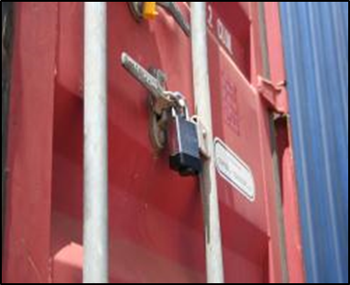
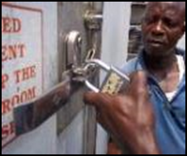
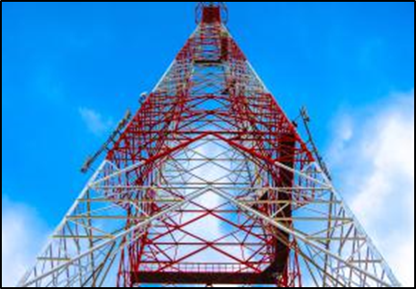
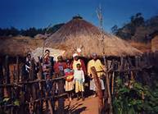
Better security, better life!
info@acsys.com
EN1303（G5）

